Slide 1
Generative Models Discriminative vs Generative
Understanding Machine Learning

Slide 2
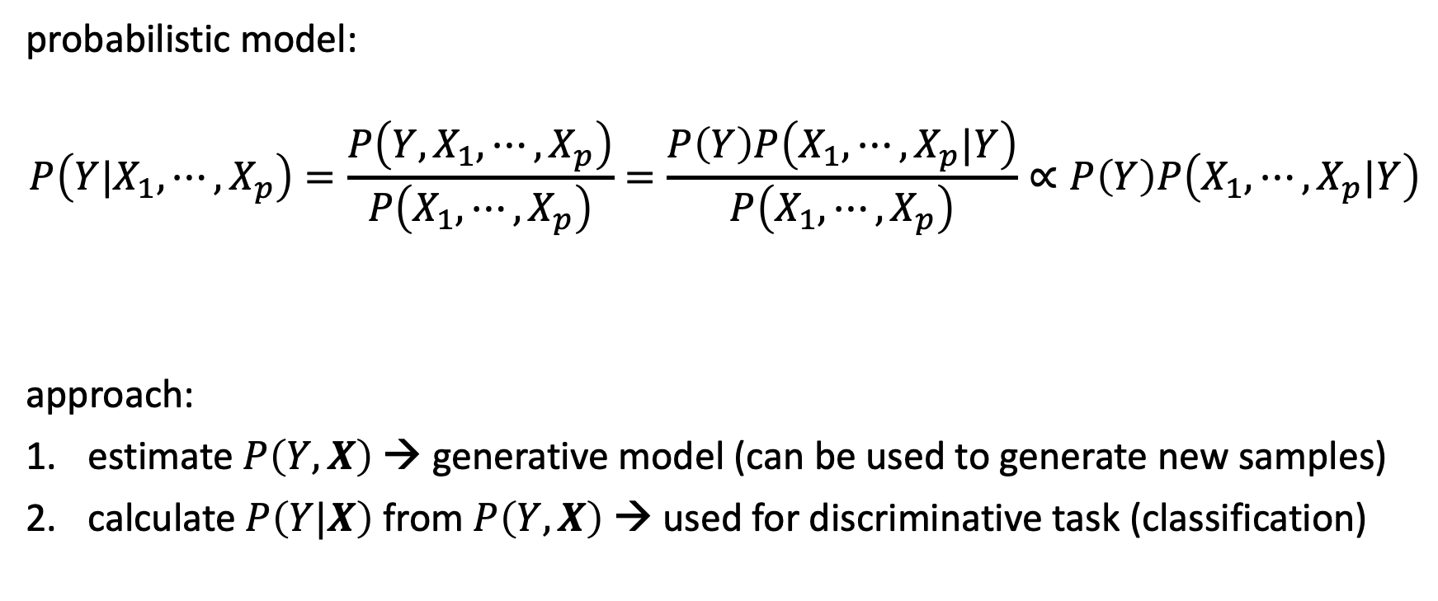
Archetype: Naïve Bayes
probabilistic model:
$$P\left(Y|X_{1}, ⋯,X_{p}\right)=\frac{P\left({Y,X}_{1}, ⋯,X_{p}\right)}{P\left(X_{1}, ⋯,X_{p}\right)}=\frac{P\left(Y\right)P\left(X_{1}, ⋯,X_{p}|Y\right)}{P\left(X_{1}, ⋯,X_{p}\right)}∝P\left(Y\right)P\left(X_{1}, ⋯,X_{p}|Y\right)$$
approach:
estimate $P\left(Y,X\right)$ → generative model (can be used to generate new samples)
calculate $P\left(Y|X\right)$ from $P\left(Y,X\right)$ → used for discriminative task (classification)
Bayes’ rule
constant
to be estimated

Slide 3

Independence Assumption
(naïve) assumption: conditional independence of features given target
$$P\left(X_{j}|Y,X_{1},{⋯,X}_{j−1},X_{j+1},⋯,X_{p}\right)=P\left(X_{j}|Y\right)$$
$$⟹P\left(Y|X_{1}, ⋯,X_{p}\right)=\frac{P\left(Y\right)\prod_{j=1}^{p}{P\left(X_{j}|Y\right)}}{P\left(X_{1},⋯,X_{p}\right)}$$
→ independent feature contributions (ignoring feature correlations)
→ robust against curse of dimensionality

Slide 4

Estimation of Feature Contributions
separate estimations of $P\left(X_{j}|Y\right)$ for each feature
requires assumption of distributions (e.g., Gaussian naïve Bayes) or non-parametric methods (kernel density estimation)
$P\left(x_{ij}|y\right)=\frac{1}{\sqrt{2πσ_{y,j}^{2}}}\exp\left(−\frac{{\left(x_{ij}−μ_{y,j}\right)}^{2}}{2σ_{y,j}^{2}}\right)$
parameter estimation (e.g., mean and variance of Gaussians) can be done with maximum likelihood method ($y$ known in training)
→ no Bayesian methods needed
Gaussian feature likelihoods:

Slide 5
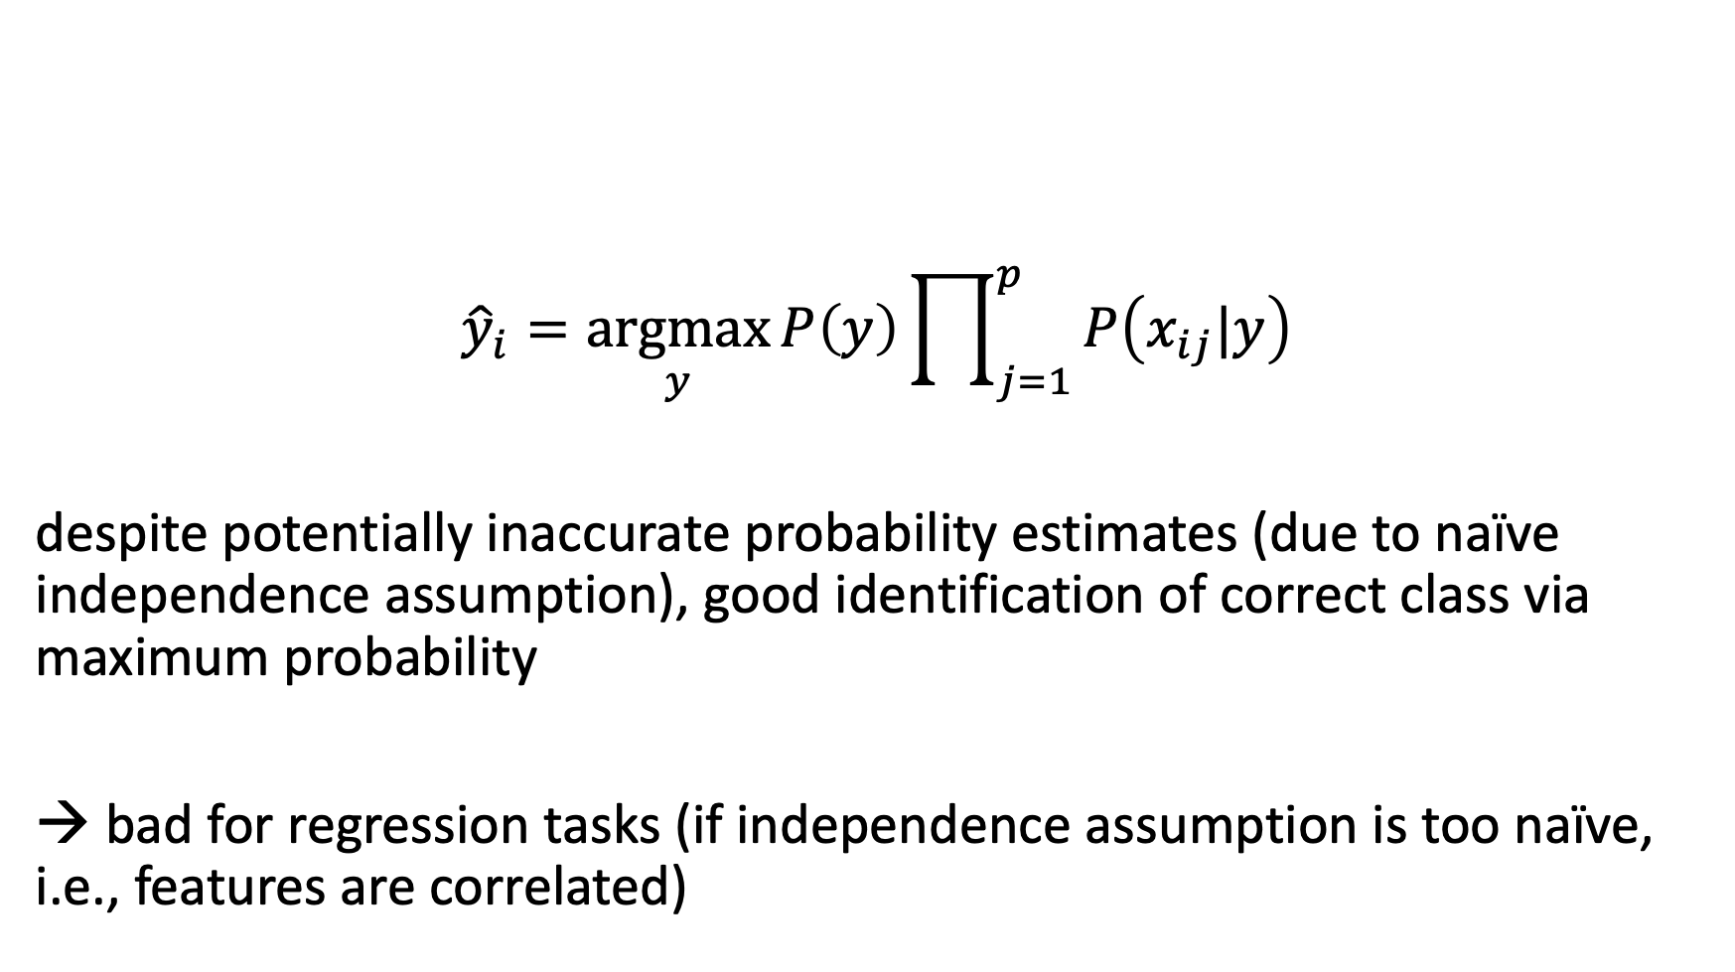
Maximum a Posteriori Classification
$${\hat{y}}_{i}=\underset{y}{argmax}{P\left(y\right)\prod_{j=1}^{p}{P\left(x_{ij}|y\right)}}$$
despite potentially inaccurate probability estimates (due to naïve independence assumption), good identification of correct class via maximum probability
→ bad for regression tasks (if independence assumption is too naïve, i.e., features are correlated)

Slide 6

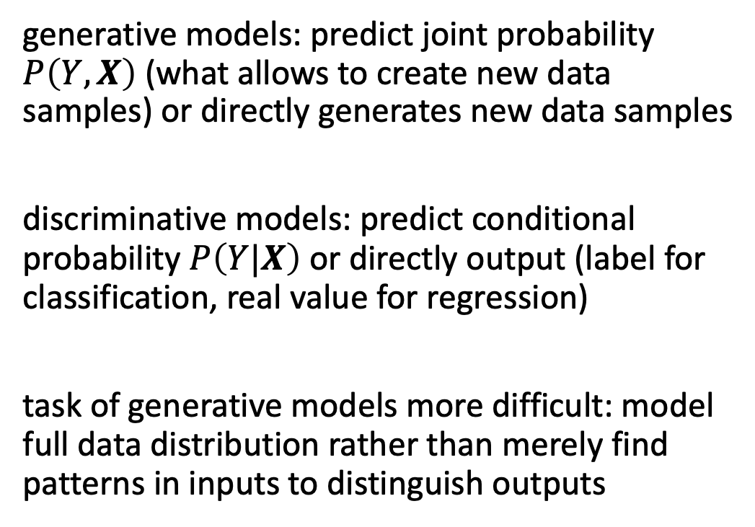
Generative vs Discriminative Models
generative models: predict joint probability $P\left(Y,X\right)$ (what allows to create new data samples) or directly generates new data samples
discriminative models: predict conditional probability $P\left(Y|X\right)$ or directly output (label for classification, real value for regression)
task of generative models more difficult: model full data distribution rather than merely find patterns in inputs to distinguish outputs
discriminative model
generative model
source

Slide 7
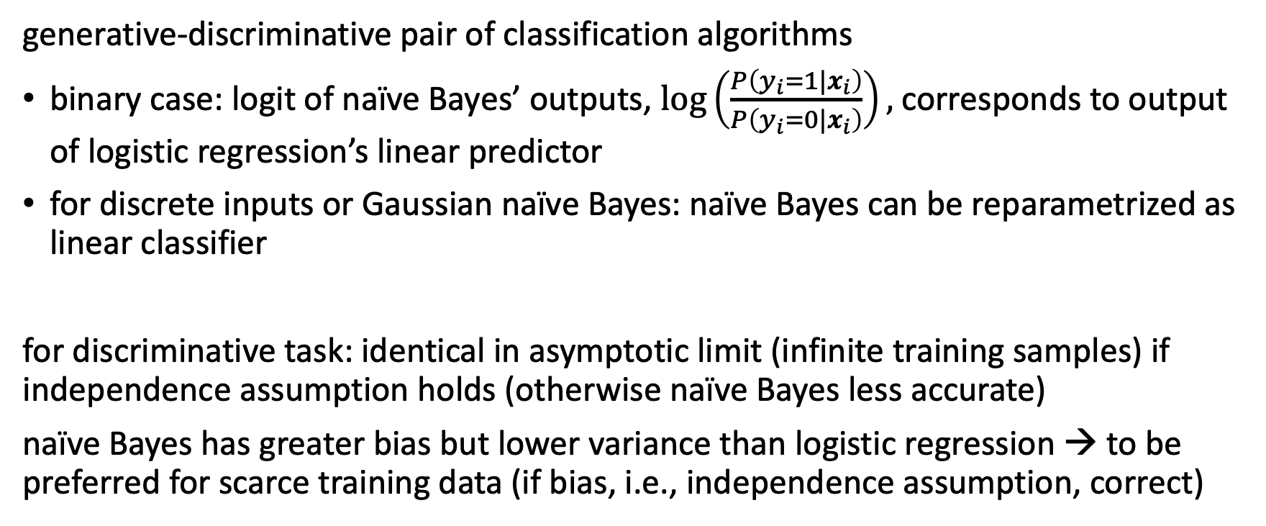
Naïve Bayes and Logistic Regression
generative-discriminative pair of classification algorithms
binary case: logit of naïve Bayes’ outputs, $\log\left(\frac{P\left(y_{i}=1|x_{i}\right)}{P\left(y_{i}=0|x_{i}\right)}\right),$ corresponds to output of logistic regression’s linear predictor
for discrete inputs or Gaussian naïve Bayes: naïve Bayes can be reparametrized as linear classifier
for discriminative task: identical in asymptotic limit (infinite training samples) if independence assumption holds (otherwise naïve Bayes less accurate)
naïve Bayes has greater bias but lower variance than logistic regression → to be preferred for scarce training data (if bias, i.e., independence assumption, correct)

Slide 8
Data Generation
generative models can be used for discriminative tasks (although potentially inferior to direct discriminative methods)
but generative methods do more than discriminative ones: model full data distribution
→ allows generation of new data samples (can be images, text, video, audio, proteins, materials, time series, structured data, …)
large (auto-regressive) language models examples of generative models

Slide 9

Different Types of Generative Models
source

Slide 10
Variational Autoencoder (VAE)

Slide 11

Recap: Autoencoder
(deep) encoder network
(deep) decoder network
learned together by minimizing differences between original input and reconstructed input (expressed as losses)
compressed intermediate representation: dimensionality reduction
source

Slide 12

Idea
…
from wikipedia

Slide 13
Variational Inference
Bayesian …

Slide 14

Surrogate Loss
…
VAE relies on a surrogate loss
source

Slide 15
ELBO

Slide 16

Reparameterization Trick
…
from wikipedia

Slide 17

Putting Everything Together
…
from wikipedia

Slide 18
Generative Adversarial Networks (GAN)

Slide 19
Zero-Sum Game
…
two neural networks playing a zero-sum game …

Slide 20

…
… noise
source

Slide 21
Issues in GANs
…
…potentially unstable training and less diversity in generation

Slide 22
Flow-Based Methods

Slide 23

…
source

Slide 24
specialized architectures to construct reversible transform

Slide 26
Diffusion Models

Slide 27

Denoising Autoencoder
…
source

Slide 28
…chain of denoising autoencoders…
inspired by non-equilibrium thermodynamics
Markov chain of diffusion steps to slowly add random noise to data
then learn to reverse the diffusion process to construct desired data samples from the noise
Unlike VAE or flow models, diffusion models are learned with a fixed procedure and the latent variable has high dimensionality (same as the original data).

Slide 29

…
source

Slide 32
Image Generation
DALL-E 2

Slide 33

…
Stable Diffusion
DreamStudio

Slide 34
Literature
papers:
variational autoencoder
GAN
normalizing flows
latent diffusion

Slide 35


Movie-like Intelligence
emergent capabilities of complex systems almost impossible to foresee
mini examples in contemporary ML:
large language models
multi-agent reinforcement learning
one idea: reward is enough
philosophical: emotions or consciousness might also occur as emergent capabilities

